Slide 1


Session 6: System Architecture
& Implementation Strategy
Introduction to Software Engineering

Slide 2






Lecture Agenda
Architecture
Strategy
Implementation
Code Quality
Common patterns: Client-Server, Layered, MVC, and Microservices.
Monolithic vs. Layered choices and selecting the right Tech Stack.
Folder structures, Naming conventions, and Dependency management.
Intro to Clean Code principles and the art of Refactoring.

Slide 3
Architectural Patterns
Designing the Blueprint for Scalability and Maintenance

Slide 4
What is Software Architecture?
Definition: The high-level structure of a software system, the discipline of creating such structures, and the documentation of these structures.
The "Why": It provides a common abstraction of the system that most, if not all, of the system's stakeholders can use as a basis for mutual understanding.
Decision Making: Architecture represents the set of significant design decisions (hard to change later).
Quality Attributes: Directly impacts performance, scalability, security, and maintainability.

Slide 5


Common Architectural Styles
Monolithic
Client-Server
Layered (N-Tier)
MVC
Microservices
Simple development, easy debugging, fast initial deployment.
Distributed workloads between service providers and requesters.
Organizing code into logical horizontal layers.
Separating UI, Data, and Control logic.
Suite of small, independent services communicating via APIs.

Slide 6
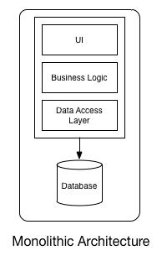
Monolithic Architecture
Single unified codebase and deployment unit
Advantages: Simple development, easy debugging, fast initial deployment
Disadvantages: Tight coupling, difficult to scale, “Big Ball of Mud” risk
Diagram: One large block containing UI, Business Logic, Database

Slide 7

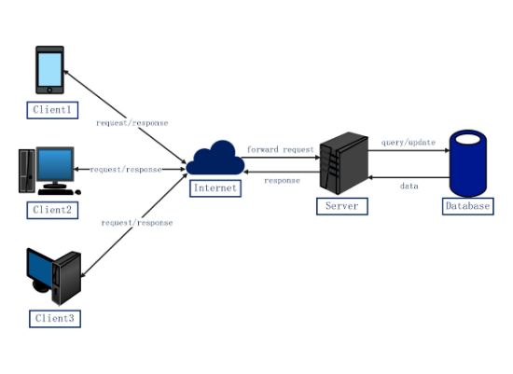
Client-Server Architecture
Concept: Clients request resources; Servers provide them.
Centralization: Data is usually kept on the server for security and consistency.
Scalability: Can scale the server horizontally to handle more clients.
Common Use: Web applications, Email, and Database access.

Slide 8
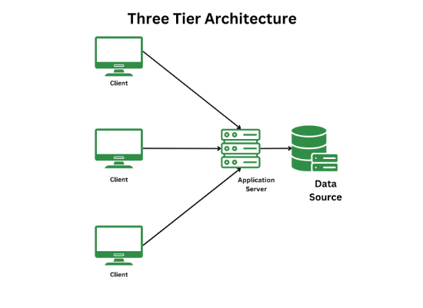
Layered (N-Tier) Architecture
Presentation Layer: User interface and browser communication.
Business Layer: Core logic and domain rules
Persistence Layer: Data access objects (DAO) and ORM.
Database Layer: Physical storage (SQL/NoSQL).
Clear separation of concerns
Advantages: Maintainability, testability, technology flexibility per layer
Common in enterprise applications

Slide 9
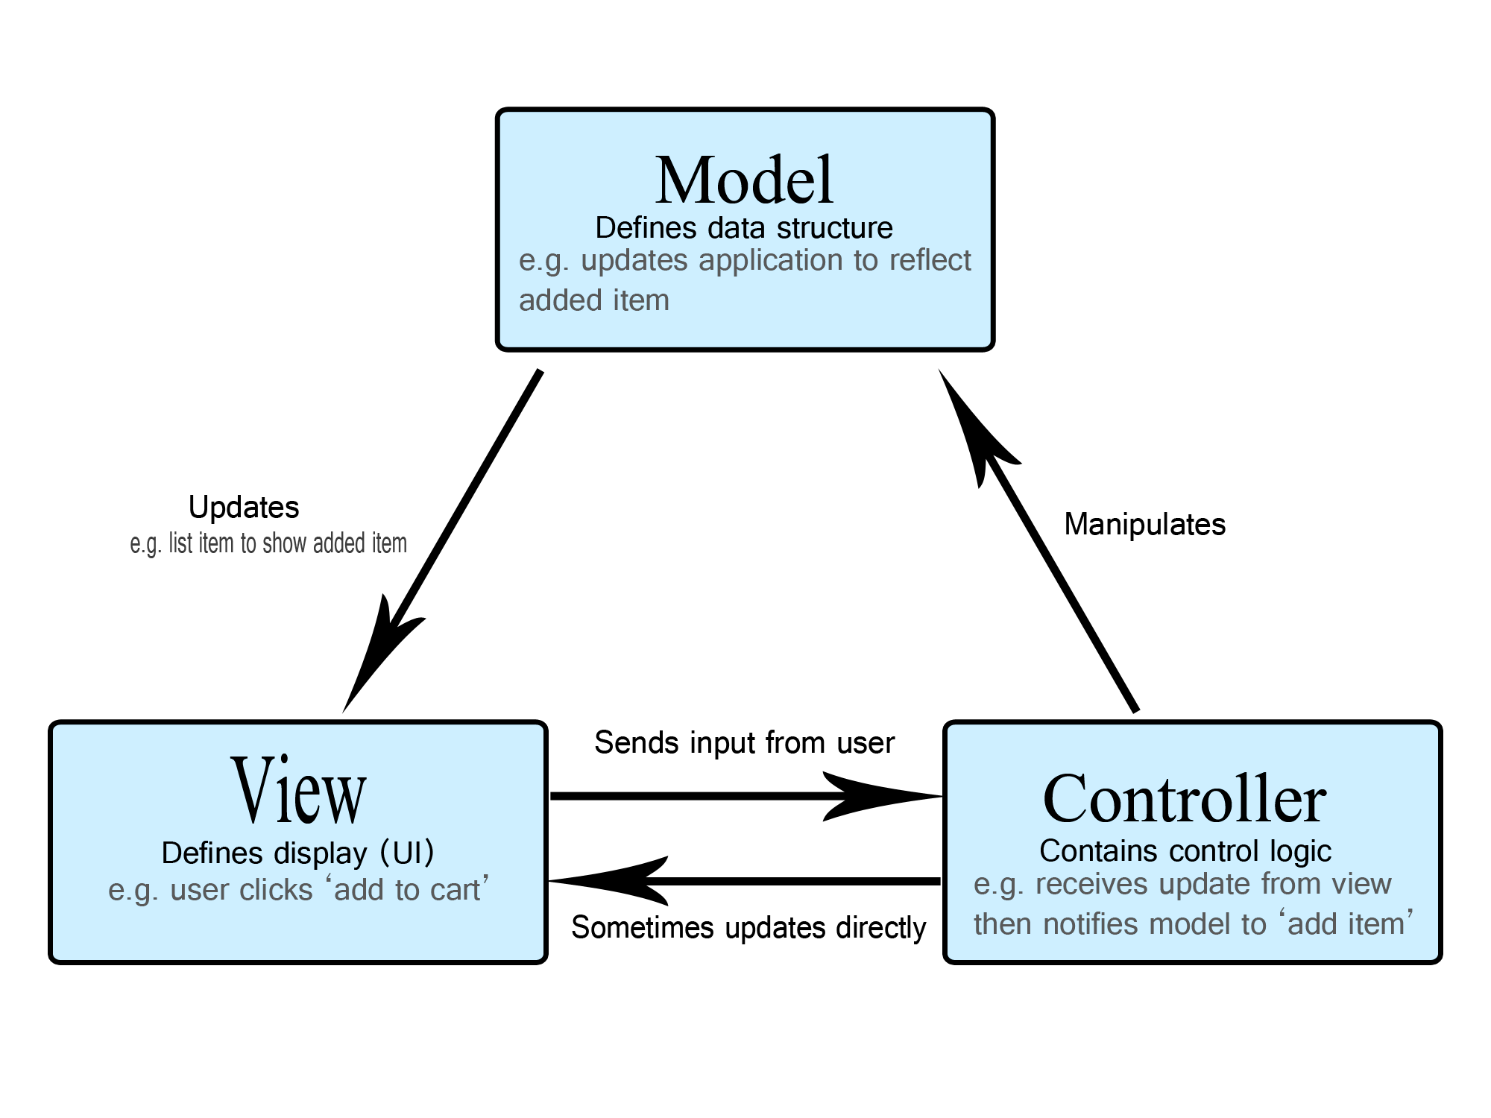
Model-View-Controller (MVC)
Model: Manages data and business logic. Notifies View of changes.
View: Renders the Model into a format suitable for interaction.
Controller: Processes user input, interacts with Model, and updates View.
Popular in web frameworks (ASP.NET MVC, Spring MVC, Laravel)
Benefit: Simultaneous development and high cohesion.

Slide 10
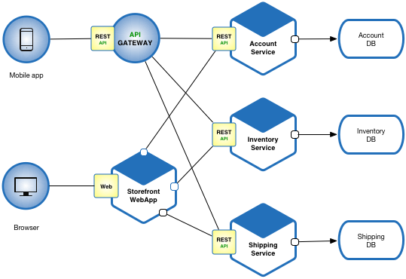
Microservices Architecture
Decentralization: Each service has its own database and business logic.
Independence: Services can be deployed and scaled separately.
Technology Heterogeneity: Different services can use different tech stacks.
Complexity: Requires robust API management and service discovery.
Advantages: Independent deployment, technology diversity, fault isolation
Disadvantages: Complexity in distributed systems, network latency, DevOps overhead
When to use: Large-scale, complex domains

Slide 11
Implementation Strategy
Choosing the Right Tools and Structure

Slide 12
Monolithic vs. Layered Choice
Criteria | Monolithic | Layered / Microservices
Complexity | Low initial complexity | High structural complexity
Deployment | Easy (one unit) | Complex (multiple pipelines)
Scalability | Scales the whole app | Granular scaling per service
Maintenance | Becomes harder over time | Better separation, easier isolated fixes

Slide 13
Choosing Architecture – Decision Factors
Team size & expertise
Project scale & expected growth
Performance & scalability requirements
Time to market
Maintenance window & operational complexity
Decision matrix (simple table)

Slide 14
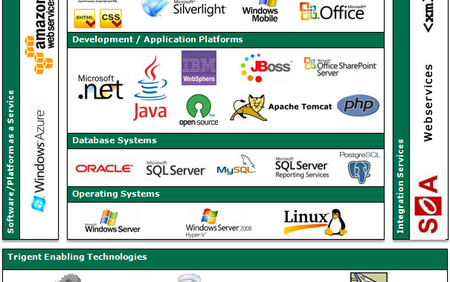
Selecting the Tech Stack
Choosing the right technology stack is a critical decision that influences performance, team productivity, and long-term costs.
Factors to consider: team expertise, community support, library ecosystem, and security compliance.

Slide 15






Technology Selection Factors
Team Skill
Community
Performance
Can the current team build and maintain this efficiently?
Is there a large community for troubleshooting and plugins?
Does the runtime meet the latency requirements?

Slide 16
Stack Evaluation Criteria
Learning curve
Performance & scalability
Security features
Integration capabilities
Licensing & cost
Team familiarity (important for startups)

Slide 17
Project Organization
Structuring Folders and Naming Conventions

Slide 18
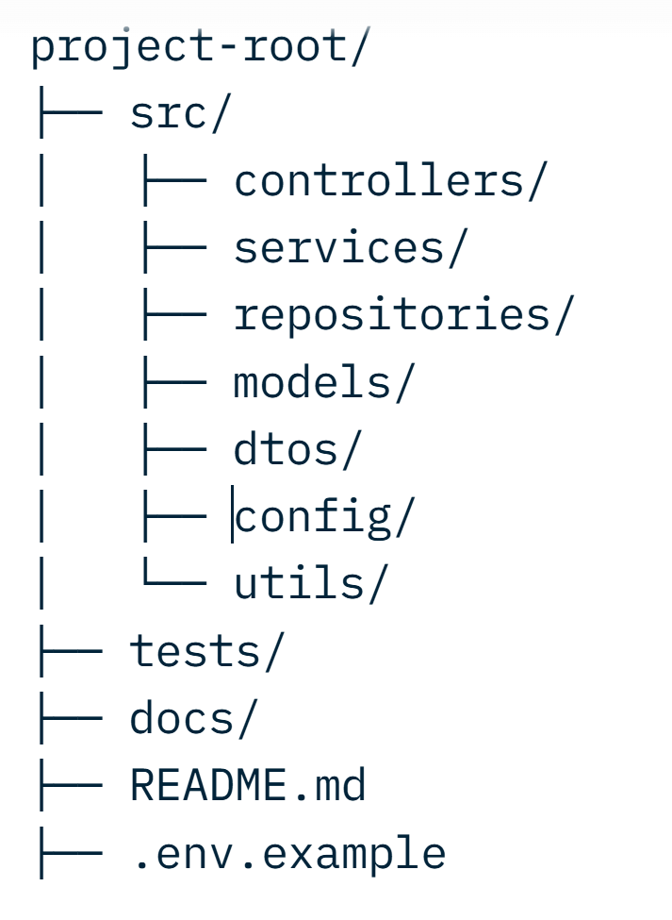
Standard Layer Folder Structure Example
/src: Main source code files
/tests: Unit, Integration, and E2E tests.
/docs: Project documentation and diagrams.
/assets: Static images, styles, fonts.
/config: Environment-specific settings
/lib: Internal or shared libraries.

Slide 19
Naming Conventions – Core Principles
Be consistent
Be descriptive
Follow language/framework conventions
Use domain language (Ubiquitous Language)

Slide 20
Naming Standards
Style | Usage Example | Typical Domain
PascalCase | UserProfileController | Class names, Types
camelCase | calculateTotalValue() | Methods, Local variables
snake_case | user_id, db_config | Databases, Python, C
kebab-case | header-container | CSS classes, URL paths

Slide 21
Dependency Management
Definition: Managing third-party libraries (SDKs, Frameworks) to avoid conflicts and security vulnerabilities.
Lock Files: Always use lock files (e.g., package-lock.json, Gemfile.lock, yarn.lock, poetry.lock) to ensure consistent builds across teams.
Avoid wildcard versions
Regular updates & vulnerability scanning
Separate production vs development dependencies
Transitive Dependencies: Be aware that libraries you use have their own dependencies.
Tools: npm/yarn (JS), Maven/Gradle (Java), Pip (Python), NuGet (.NET).

Slide 22
Intro to Clean Code
Code is Read More Often Than it is Written

Slide 23
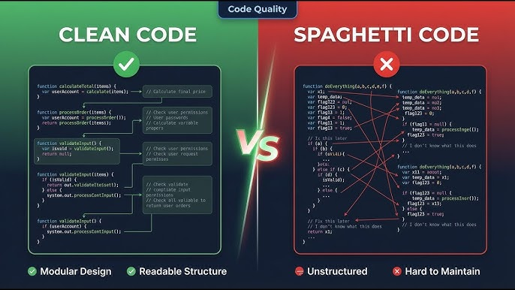
What is Clean Code?
Readability: Can a new developer understand the logic in 30 seconds?
Simplicity: Does it follow the KISS principle (Keep It Simple, Stupid)?
Maintenance: Is it easy to change without breaking other parts?
Testability: Can it be easily verified with automated tests?

Slide 24



Meaningful Names
Avoid Intent-Obscuring
Pronounceable Names
Searchable Names
Bad: int d; // elapsed time Good: int elapsedTimeInDays;
Bad: genymdhms Good: generationTimestamp
Avoid magic numbers like 86400. Use SECONDS_IN_A_DAY.

Slide 25
Single Responsibility Principle
A class or function should have one, and only one, reason to change.
If a function is longer than 20 lines, it might be doing too much.
Cohesion: High cohesion means the parts of a module belong together.
Split complex logic into smaller, helper functions
Comments: Explain “why”, not “what”.

Slide 26
Clean Code Principles
DRY (Don’t Repeat Yourself)
KISS (Keep It Simple, Stupid).
YAGNI (You Aren’t Gonna Need It)
Error handling strategy

Slide 27


Common "Code Smells"
Long Method
Large Class
Duplicate Code
Feature Envy
Methods with too many lines of code.
Classes trying to be a "God Object".
Violates the DRY (Don't Repeat Yourself) principle.
A method using data from another class more than its own.

Slide 28
Refactoring Techniques
The Systematic Process of Improving Design

Slide 29
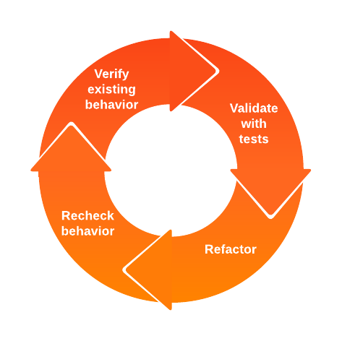
What is Refactoring?
Definition: Changing the internal structure of code without changing its external behavior.
Goal: To make the code easier to understand and cheaper to modify.
When? Regularly. During code reviews, when adding a feature, or fixing a bug.
Rule: Never refactor and add features at the same time.

Slide 30
Common Refactoring Patterns
Technique | Description | Problem Solved
Extract Method | Move logic to a new private method | Long method / Logic complexity
Rename Variable/Class | Give a better, descriptive name | Unclear intent
Inline Method | Replace call with method body | Useless indirection
Replace Magic Number with Constants | Use a named constant | Hidden logic/difficulty in search

Slide 31
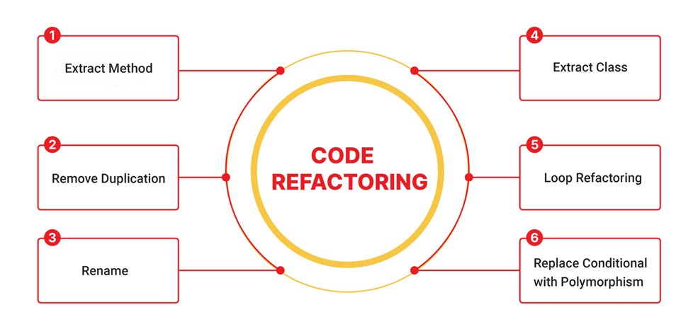
Foundational Resource
Clean Code (2008): Written by Robert C. Martin ("Uncle Bob").
Core Message: Writing clean code is about professional craftsmanship.
Key Rule: Leaving the code "cleaner than you found it" (The Boy Scout Rule).

Slide 32
Daily Clean Code Checklist
Names are descriptive and distinct.
Functions are small and do one thing.
Function arguments are kept to a minimum (0-3).
No commented-out code is left in the repository.
Error handling is separated from main logic.

Slide 33
Industry Standard: Comments
Good Comments
Bad Comments
The Golden Rule
Legal comments, informative (regex explanation), warnings, TODOs.
Redundant comments, noisy comments, source code snapshots.
"Don't comment bad code — rewrite it." (Kernighan & Plauger)

Slide 34
Strategic Implementation Flow
Plan
Setup
Code
Review
Select Arch & Stack
Define Structure & Deps
Clean Code Implementation
Refactor & Optimize

Slide 35
Session Key Takeaways
Architecture matters: It is the skeleton that supports all features.
Consistency: Folders and naming provide the mental map for the team.
Hygiene: Dependency management and Clean Code prevent technical debt.
Continuous Improvement: Refactoring is not a one-time event but a habit.

Slide 36
Questions & Answers

